Slide 1
Did It Happen?
Insurance Claim Fraud Detection with Machine Learning
Neil Bhikha | Institute of Data
Notes:
Good afternoon everyone
This is my capstone presentation
Did it happen?
The topic is: Insurance claim fraud detection with machine learning

Slide 2
Contents
Insurance Fraud:
Business Context:
Data Set:
Processing:
Machine Learning Results:
Conclusion:
Introduction to the topic
How will this help?
Exploratory analysis
Steps taken to prepare data
What was the best model?
Let’s talk about capital
Notes:
Here is a brief overview of what we will cover today
But before we start
Raise your hands if you don’t have insurance of any sort? - okay cool everyone knows the basics of insurance

Slide 3
Insurance Fraud
What is it?
Illegally benefiting from their policy that they’re not entitled to.
Examples:
Exaggerated claims
Events / Losses that didn’t happen
Staged losses – vehicle theft, crashing on purpose.
New Zealand:
Current year $580,000,000 | Still going up
Cost of fraud is passed onto you
Higher the fraud the more you pay!
Notes:
Insurance fraud:
What is it? - Basically insurance fraud is when someone does something they shouldn’t do under their policy. They are illegally obtaining benefits in a way that they aren't entitled to.
example :
- exaggerated claims
- events/losses that didn’t happen
- staged losses – like vehicle theft, crashing on purpose.
How does this affect you?
The estimated cost of insurance fraud in New Zealand to all policyholders this year is 580 million this is still going up
Insurance fraud increases insurers’ operating costs through additional time, staff and investigation. These costs also need to be passed on to consumers.
The larger the size of the dishonest claim, the more everyone ends up paying.

Slide 4
Business
What is happening?
Fraud Claims are coming in at an Increasing Rate
Increasing the cost for the business and consumers
Decrease in customer satisfaction
Solution
Implement a Machine Learning model that can predict fraud claims
Benefits
Increase efficiency for claims process
Reduce: additional time, staff and investigation costs
Decrease capital loss which Increase customer satisfaction/ retention
Notes:
Business Context
Currently insurance claims are coming in at an increasing rate.
Investigating each claim to see if it is legitimate is very time consuming and expensive.
If the illegitimate claim slips through the vetting process that will lead to losses for the company and the consumers.
The more loss that occurs the more the company will have to charge its customers, which leads to a decrease in customer satisfaction.
What if we can implement a machine learning model that can predict which claims are fraud?
This would increase efficiency for the claims process and would reduce the amount of additional time, staff and investigation needed.
Also decrease the amount of capital lost.
In turn this would benefit the company's customer retention and profits.
Potentially help reduce premiums

Slide 5
Investigation
Questions:
Can we predict which claims will be reported as fraud?
Can we minimise the loss of capital done by fraud?
What trends does the data show that leads to fraud? Red Flags
Implementation
We can implement Machine Learning Model when claims are filed
Highlight claims that would need to be focused on
Notes:
What going to investigate is
- Can we predict which claims that will be reported as fraud?
- Can we minimise the loss of capital done by fraud?
- What trends does the data show that leads to fraud? - Red Flags
### Where would the company implement this?
- This Machine Learning Model would come in when the claim is filed as long as we have all the required information we should be able to predict which claims are fraud.
-This would Highlight claims that would need to be focused on.

Slide 6
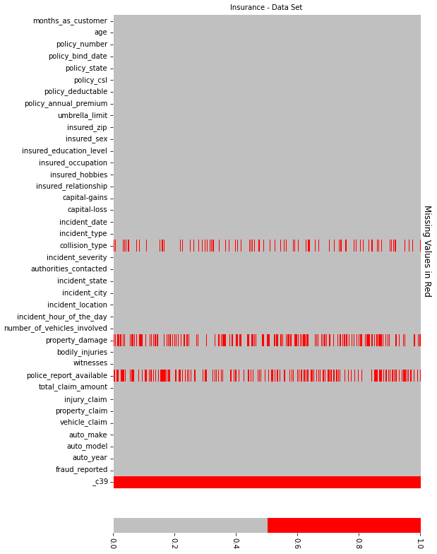
The Data
Auto Insurances Claims
1000 Samples
39 Variables
Location USA: Three states
Notes:
- The data set consist of 1000 auto incidents - this is mainly to do with cars
- The data set has a total of 39 variables.
auto insurance claims are from three states in America: Ohio, Illinois and Indiana

Slide 7
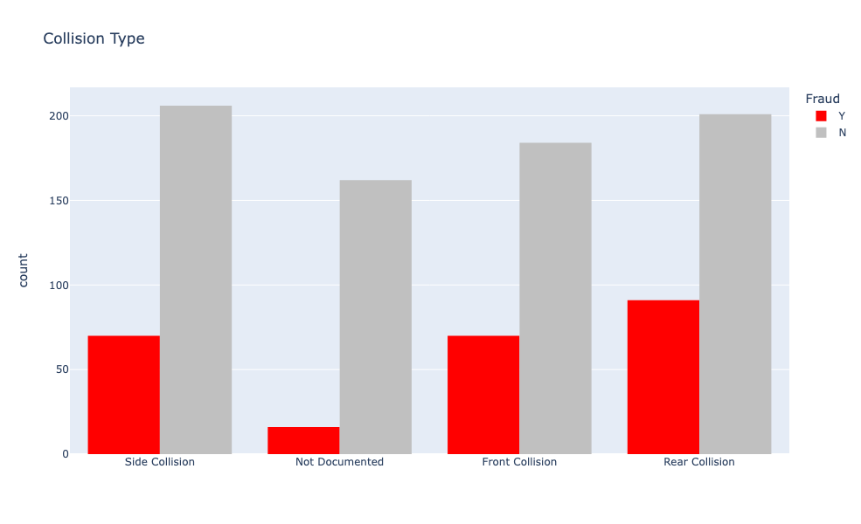
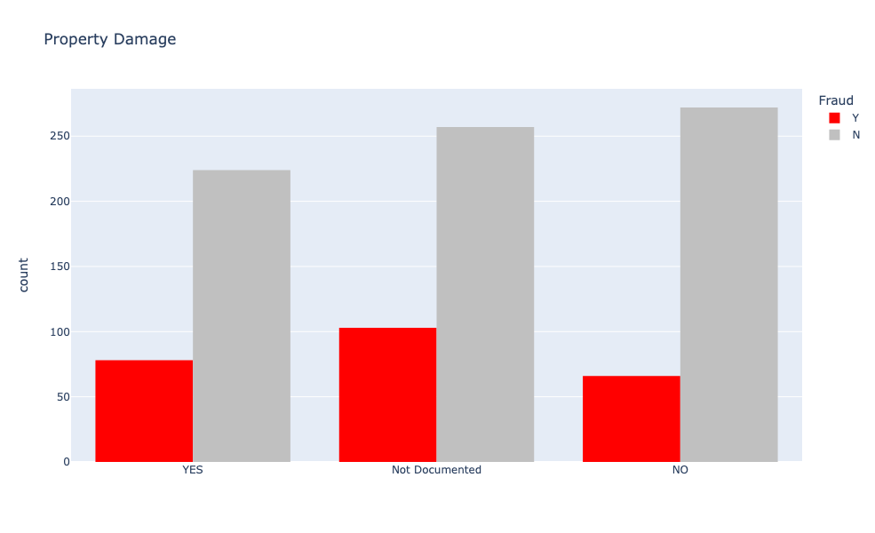
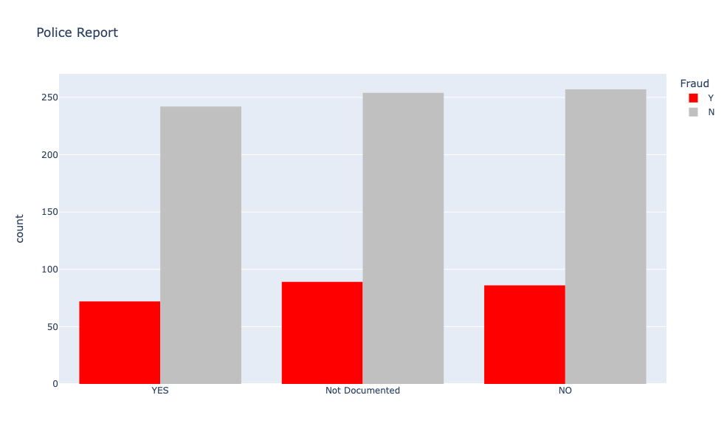
Explore
Three Variables had missing values as ‘?’
Replaced with ‘Not Documented’
Suspicious
Notes:
Some interesting things i found during the cleaning process
There were 3 variables [collision_type, police_report_available, property_damage] that contained values "?".
- I decided to impute them with the word "Not documented" instead of dropping them as they may be important.
- Missing information from these variables may be a predictor to fraud.
- for example collision type or on a police report missing seems suspicious.

Slide 8
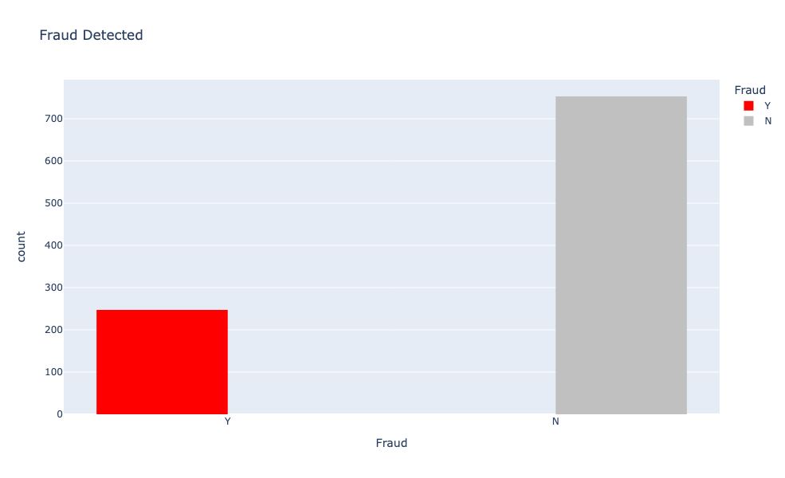
Fraud
247 Cases of Auto Insurance Fraud
Imbalance
75.3%
24.7%
Notes:
There were 247 reported fraud claims and 753 non-frauds.
Would be nice to have 50/50 split of fraud as this would potentially help during the machine learning stage

Slide 9
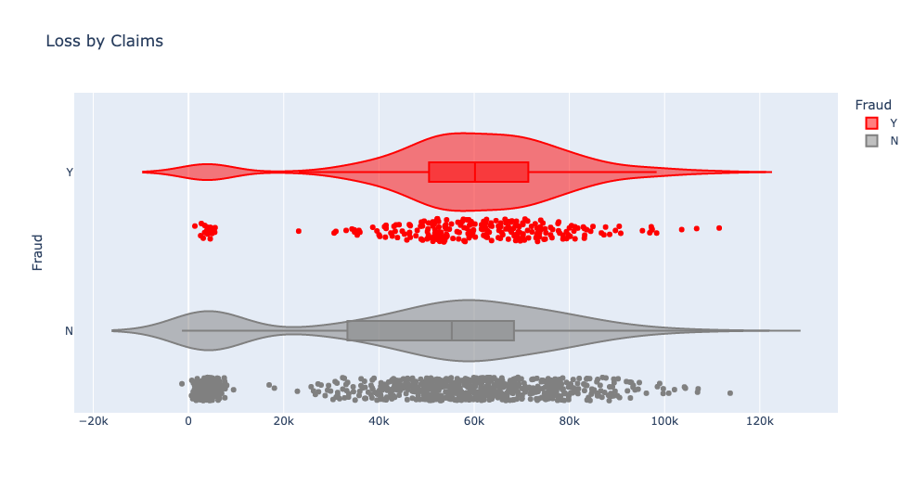
Monetary
- 32.5% capital lost due to fraud
Amount claimed 28.23% was fraud claims
$14,900,000 was claimed by fraudsters
Notes:
Let's look at money
The graph we are looking at here is - Loss by claim which is a feature that i engineered that is made from total claim amount minus by Annual policy premium
We will be looking at Capital for this data set:
The company is losing out on -32.5% of capital due to fraud
Imagine what you could do with 32.5% of extra capital
In terms of the amount claimed 28.23% was reported as fraud claims
That equates to $14.9 million that was taken away
We hope that implementing something that would reduce these numbers

Slide 10
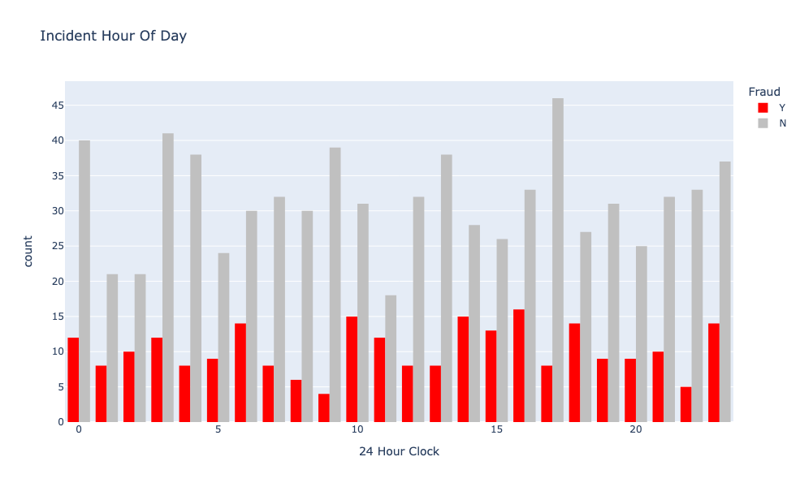
Red Flags
What time matters?
Spikes
Notes:
Does time of day matter?
You’d imagine fraudsters shouldn’t be able to get a good night's sleep as they should be worried about a machine learning their patterns.
Fraudsters seem to strike at certain hours
There's spikes around 11pm and 12am
Then at the witching hour - 3am
Then it seems like they fall asleep and wake up at 6am
They stop to have some breakfast then start again at 10 and 11am
Take a break for lunch begin again between 2pm and 4pm
Just before dinner 6pm they strike

Slide 11
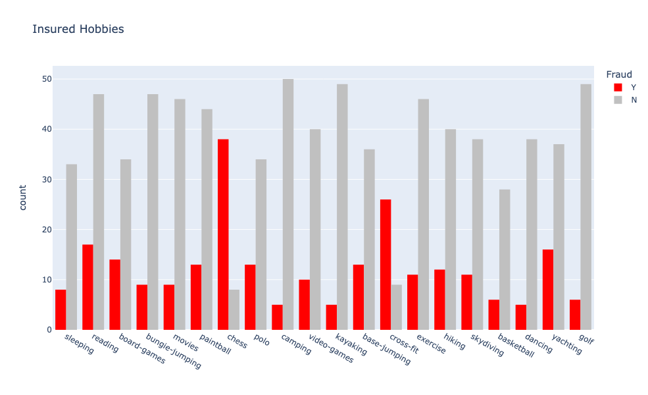
Red Flags
Hobbies say more
Highest fraud chess and crossfit
Board games and yachting do stand out
Pure hearted people play golf
Notes:
Your hobbies would say more about you than you think
Like if your hobby involves sleeping then I wouldn't worry too much about you
But if you play chess then i know you’re probably planning your next illigal move
Also always knew something not right about crossfit
Board games and yachting also seem to stand out
And I suppose a lot of good people play golf

Slide 12
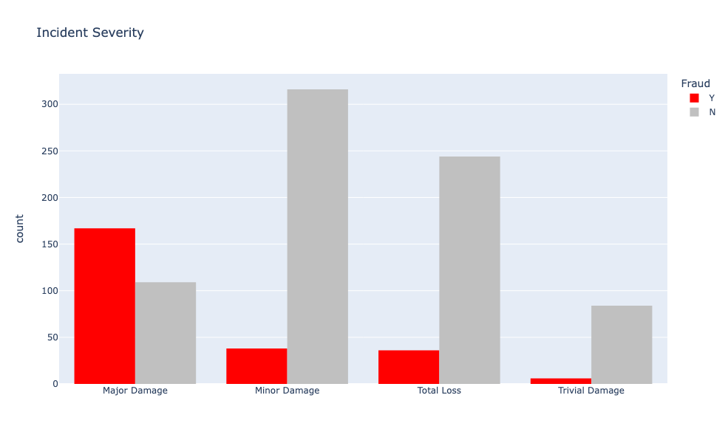
Red Flags
How severe is it?
Major damages could mean more $
Why isn’t total loss a popular pick?
Notes:
Incident severity
You could say going for major damage would mean you get more money
As you can see why bother with trivial damage since there's risk involved in getting caught
I'm also surprised that total loss fraud isn’t higher

Slide 13





Machine Learning
Pre-Processing
Evaluation
Data Cleaning
EDA
Modelling
Notes:
First step was cleaning the data: taking out things we don’t need
Second step was exploring the data to understand what is going on
Pre-processing is to encode the data and make a train test split - 75/25
Model the data: find best parameters using grid search and utilising SMOTE overfitting so we get a 50/50 split of fraud during training
evaluation : We will see how the best model would perform and how it’d affect the company

Slide 14

ML Trophy
Baseline: Dummy Classification: 0.753
7 Models:
Logistic Regression
KNN
SVC
Random Forest
Decision Tree
Stacking
XGBoost
Round 1
GridSearch
Round 2
Top 3 move on
SMOTE + Top 3 Models
GridSearch
Round 3
Compare the Two Best Models
Notes:
This will be a competition: survival of the fittest:
Round 1: will be 7 models with a baseline comparison model
Baseline model has been made from Dummy classification that’ll only predict Not fraud
7 Models are: Logistic Regression, KNN , SVC, Random Forest, Decision Tree, Stacking, XGBoost
They all will be supported by Gridsearch to find best parameters
Round two will be the three best performers with the help of Smote - making the training set 50/50 for fraud - also be supported by Grid search
Round three will be the comparison of the two best
to see who takes out the ML trophy

Slide 15
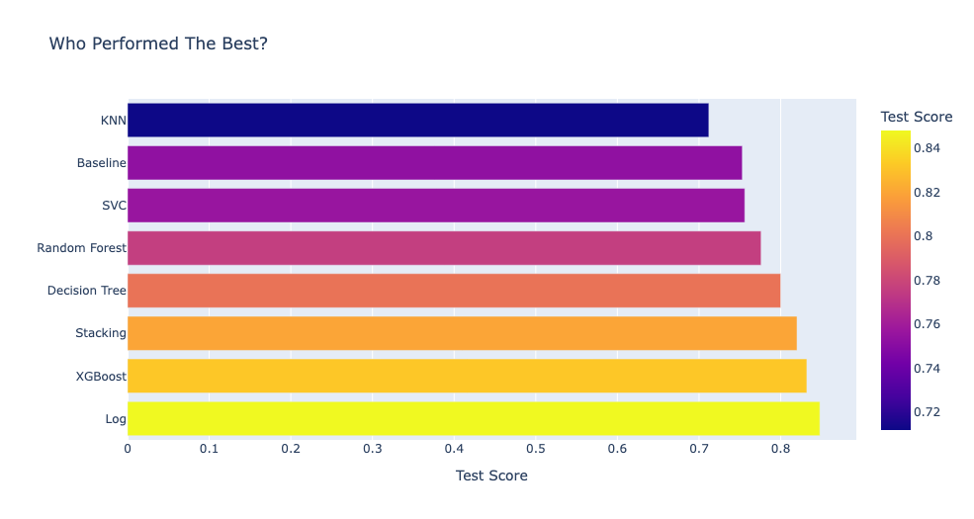
Round 1
Top 3
Logistic Regression 0.848
XGBoost 0.832
Stacking 0.82
0.80
0.82
0.832
0.848
Notes:
Round 1 results are in:
Logistic regression was the best at 84.8% accurate prediction of test data
With XGBoost coming second 83.2% accuracy
Stacking at third 82%
Followed by decision tree at 80%
I had replaced stacking with decision tree to move onto the next round

Slide 16
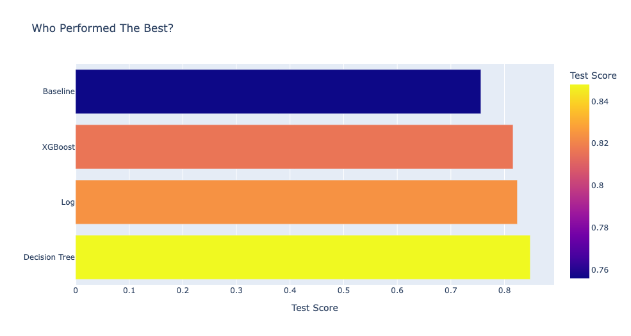
Round 2
Top 3
Decision Tree 0.848
Logistic Regression 0.824
XGBoost 0.816
0.816
0.824
0.848
Notes:
Round two
What is SMOTE
SMOTE is an oversampling technique where the synthetic samples are generated for the minority class. Which is fraud. Making training 50/50. The test is still done on the 25% test sample
We subbed out staking for decision tree
Best performance was Decision tree 84.8% test accuracy
Logistic regression coming in second
XGBoost coming in third

Slide 17
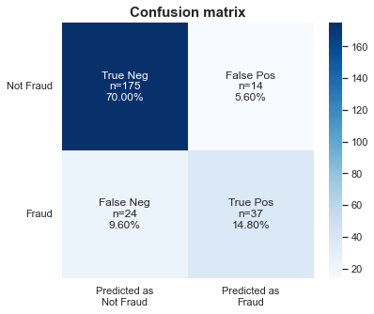
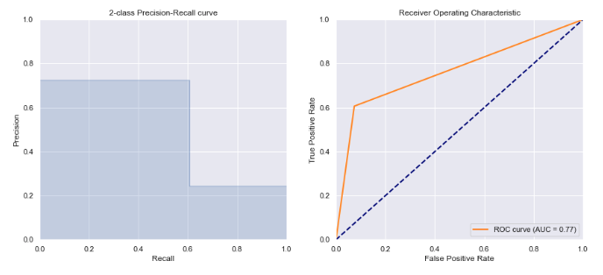
Logistic Regression
Test Score of 0.848
AUC of 0.77
15.2% False readings for test predictions
Training Score of 0.87
Notes:
Logistic Regression
Here is the confusion matrix for test results
The curve
Test Score of 0.848
AUC: 0.77
15.2% False readings for test set
Had a training Score of 0.87

Slide 18
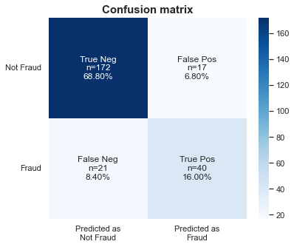
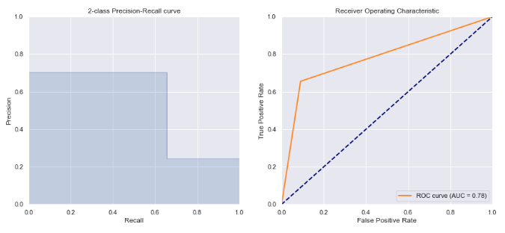
Decision Tree
With SMOTE Over fitting:
Test Score of 0.848
AUC of 0.78
15.2% False readings for test predictions
Training Score of 1
Notes:
Decision Tree
Here is the confusion matrix and the curve
Test Score of 0.848
AUC of 0.78 better by one
15.2% false readings for test predictions
Training Score of 1

Slide 19
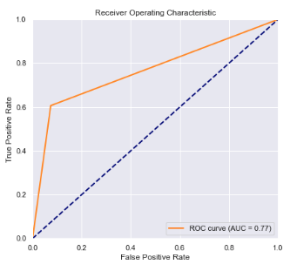
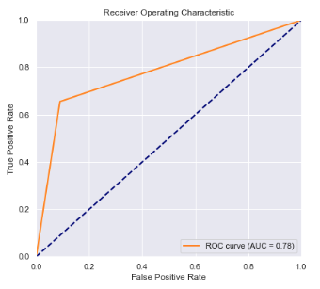
Side by Side
Logistic Regression
Decision Tree - SMOTE
Notes:
Here is a side by side of the curve
So who wins?
The slight different in AUC made the difference therefore…
This makes decision tree the winner

Slide 20

Evaluate
Winner: Decision Tree with SMOTE
Business Gains:
Quick Claim
Flag certain events and time
Underwriting: Deny addition customers
Notes:
If a company applied this model during the initial stages when a claim was submitted, They could make the triage process more streamlined.
They could make a ‘Quick Claim’ category where claims that aren't flagged/low risk are passed off for approval. This would improve efficiency.
Flag up risky events like Major damage, missing police report for senior assessors to have a look into.
This would help with distributing the claims to the appropriate people for example the high risk claims will be sent to highly experienced claims officers.
During the underwriting process we could have a better look at hobbies like chess and crossfit - potential deny additional customers that participate in this.
New Zealand: Even if we reduce fraud by half this was have a big impact on your premiums.

Slide 21
Thank you.

